Slide 1
Simple storage service (s3)
Velocity training institute
Shantanu Mahajan (sr engg devops)

Slide 2
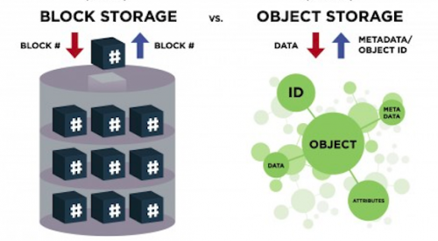
What is a object storage?
Object storage is a computer data storage architecture that manages data as objects, as opposed to other storage architectures like file systems which manages data as a file hierarchy, and block storage which manages data as blocks.

Slide 3
what is s3 in aws?
Amazon S3 or Amazon Simple Storage Service is a service offered by Amazon Web Services that provides object storage through a web service interface.
This is similar to google drive but more advanced for technical people.
This is not like block storage we cannot mount anywhere.
It’s a only drive we do not need to create any file system.
It is designed to make web-scale computing easier for IT people.
Basically, s3 is storage for the internet which has a simple webservices interface for simple storing and retrieving data anytime or from anywhere on the internet.
S3 has a distributed data-size architecture where objects are redundantly stored in multiple locations (min 3 zones).

Slide 4
Advantages
Reliable Security
All-time Availability
Very Low cost
Ease of Migration
The Simplicity of Management

Slide 5
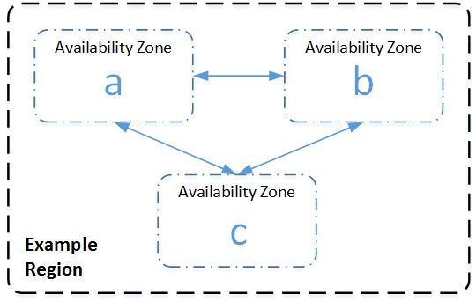
Distributed architecture
An AWS Availability Zone is a physically isolated location within an AWS Region. Within each AWS Region, S3 operates in a minimum of three AZs, each separated by miles to protect against local events like fires, power down, etc.

Slide 6
S3 concepts
Buckets
Keys
Objects
S3 bucket resources
S3 storage classes

Slide 7
Buckets/Keys/Objects
An Amazon S3 bucket is a public cloud storage resource available in Amazon Web Services' (AWS) Simple Storage Service (S3), an object storage offering.
Amazon S3 buckets, which are similar to file folders, store objects, which consist of data.
Data is stored inside a bucket.
Bucket is nothing but a flat container of objects
Max capacity of 1 bucket is 5TB
You can create or upload multiple folders in one bucket but you cannot create a bucket inside a bucket (Nested bucket not possible)
S3 bucket is region specific.
You can have 100 buckets per account, this number can be increased.
By default buckets and its objects are private, thus by default only the owner can access the buckets.

Slide 8
Buckets/Keys/Objects
There are some naming rules while creating a s3 bucket.
A S3 bucket name should be globally unique across all the regions and accounts.
Bucket names must be between 3 and 63 characters long.
Bucket names can consist only of lowercase letters, numbers, dots (.), and hyphens (-).
Bucket names must begin and end with a letter or number.
Bucket names must not be formatted as an IP address (for example, 192.168.5.4).
https://docs.aws.amazon.com/AmazonS3/latest/userguide/bucketnamingrules.html

Slide 9
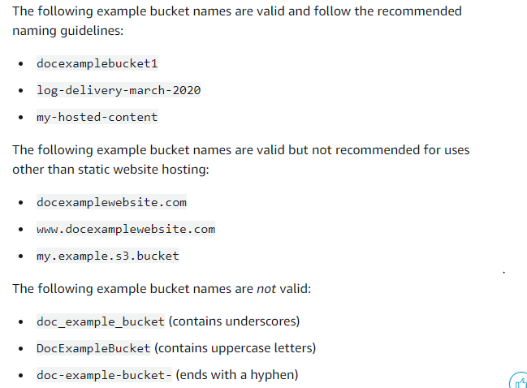

Slide 10
Buckets/Keys/Objects
An object is a file which is kept in a bucket. File can be a .txt, .html, .mp3. a photo etc.
The object key (or key name) uniquely identifies the object in an Amazon.
An object size stored in an s3 bucket can be upto 5TB.
Each object is stored and retrieved by an unique key (ID or Name)
An object in aws s3 is uniquely identified and address through the service endpoint (region), bucket name, object name (key), and version (optional)
Here the owner of the bucket can give permissions to objects, make them public or give access to particular account.

Slide 11
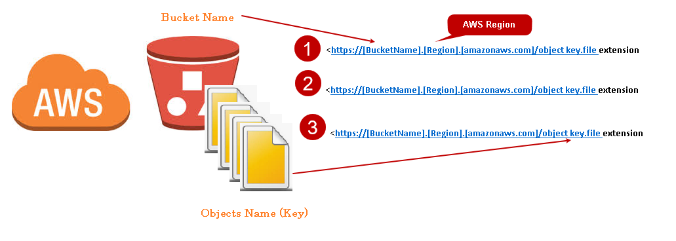

Slide 12
S3 sub resources
Lifecycle
Website
Versioning
Access control lists

Slide 13
S3 object lifecycle
A lifecycle configuration is a set of rules that are applied to the objects in specific S3 buckets.
Each rule specifies which objects are affected and when those objects will expire (on a specific date or after some number of days).

Slide 14
Website
You can use Amazon S3 to host a static website. On a static website, individual webpages include static content.
When you configure a bucket as a static website, you must enable static website hosting, configure an index document, and set permissions.
You can enable static website hosting using the Amazon S3 console, REST API, the AWS SDKs, the AWS CLI, or AWS CloudFormation.
Configuring a static website using a custom domain registered with Route 53

Slide 15
Versioning
Versioning in Amazon S3 is a means of keeping multiple variants of an object in the same bucket.
You can use the S3 Versioning feature to preserve, retrieve, and restore every version of every object stored in your buckets.
With versioning you can recover more easily from both unintended user actions and application failures.
Versioning-enabled buckets can help you recover objects from accidental deletion or overwrite
For example, if you delete an object, Amazon S3 inserts a delete marker instead of removing the object permanently.
The delete marker becomes the current object version.
You can still delete the object by deleting the delete marker.
This versioning is incremental versioning.
You can use versioning with S3 lifecycle policy to delete older versions to move them to cheaper s3 versions.
Versioning can be applied to all objects in a bucket, not partially applied

Slide 16
Access Control Lists
Amazon S3 access control lists (ACLs) enable you to manage access to buckets and objects.
Each bucket and object has an ACL attached to it as a subresource.
It defines which AWS accounts or groups are granted access and the type of access.
When a request is received against a resource, Amazon S3 checks the corresponding ACL to verify that the requester has the necessary access permissions.
https://docs.aws.amazon.com/AmazonS3/latest/userguide/acl-overview.html

Slide 17
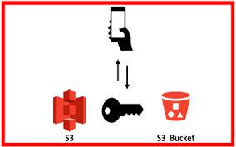
MFA delete in S3 bucket
Multifactor authentication delete is a versioning capacity that adds another level of security in case your account is compromised.
This adds another layer of security for the following
Changing your bucket versioning state or permanently deleting an object version.

Slide 18
Storage classes in amazon s3
Amazon s3 standard
Amazon glacier deep archive
Amazon glacier
Amazon s3 infrequent access (standard IA)
Amazon s3 one-zone IA
Amazon S3 intelligent tiering
Theory Link:- https://aws.amazon.com/s3/storage-classes/
Pricing link:- https://aws.amazon.com/s3/pricing/

Slide 19
Performance across the S3 Storage Classes
 | S3 Standard | S3 Intelligent-Tiering* | S3 Standard-IA | S3 One Zone-IA† | S3 Glacier | S3 Glacier
 |  |  |  |  |  | Deep Archive
Designed for durability | 100.00% | 100.00% | 100.00% | 100.00% | 100.00% | 100.00%
 | (11 9’s) | (11 9’s) | (11 9’s) | (11 9’s) | (11 9’s) | (11 9’s)
Designed for availability | 99.99% | 99.90% | 99.90% | 99.50% | 99.99% | 99.99%
Availability SLA | 99.90% | 99% | 99% | 99% | 99.90% | 99.90%
Availability Zones | ≥3 | ≥3 | ≥3 | 1 | ≥3 | ≥3
Minimum capacity charge per object | N/A | N/A | 128KB | 128KB | 40KB | 40KB
Minimum storage duration charge | N/A | N/A | 30 days | 30 days | 90 days | 180 days
Retrieval charge | N/A | N/A | per GB retrieved | per GB retrieved | per GB retrieved | per GB retrieved
First byte latency | milliseconds | milliseconds | milliseconds | milliseconds | select minutes or hours | select hours
Storage type | Object | Object | Object | Object | Object | Object
Lifecycle transitions | Yes | Yes | Yes | Yes | Yes | Yes

